Slide 1
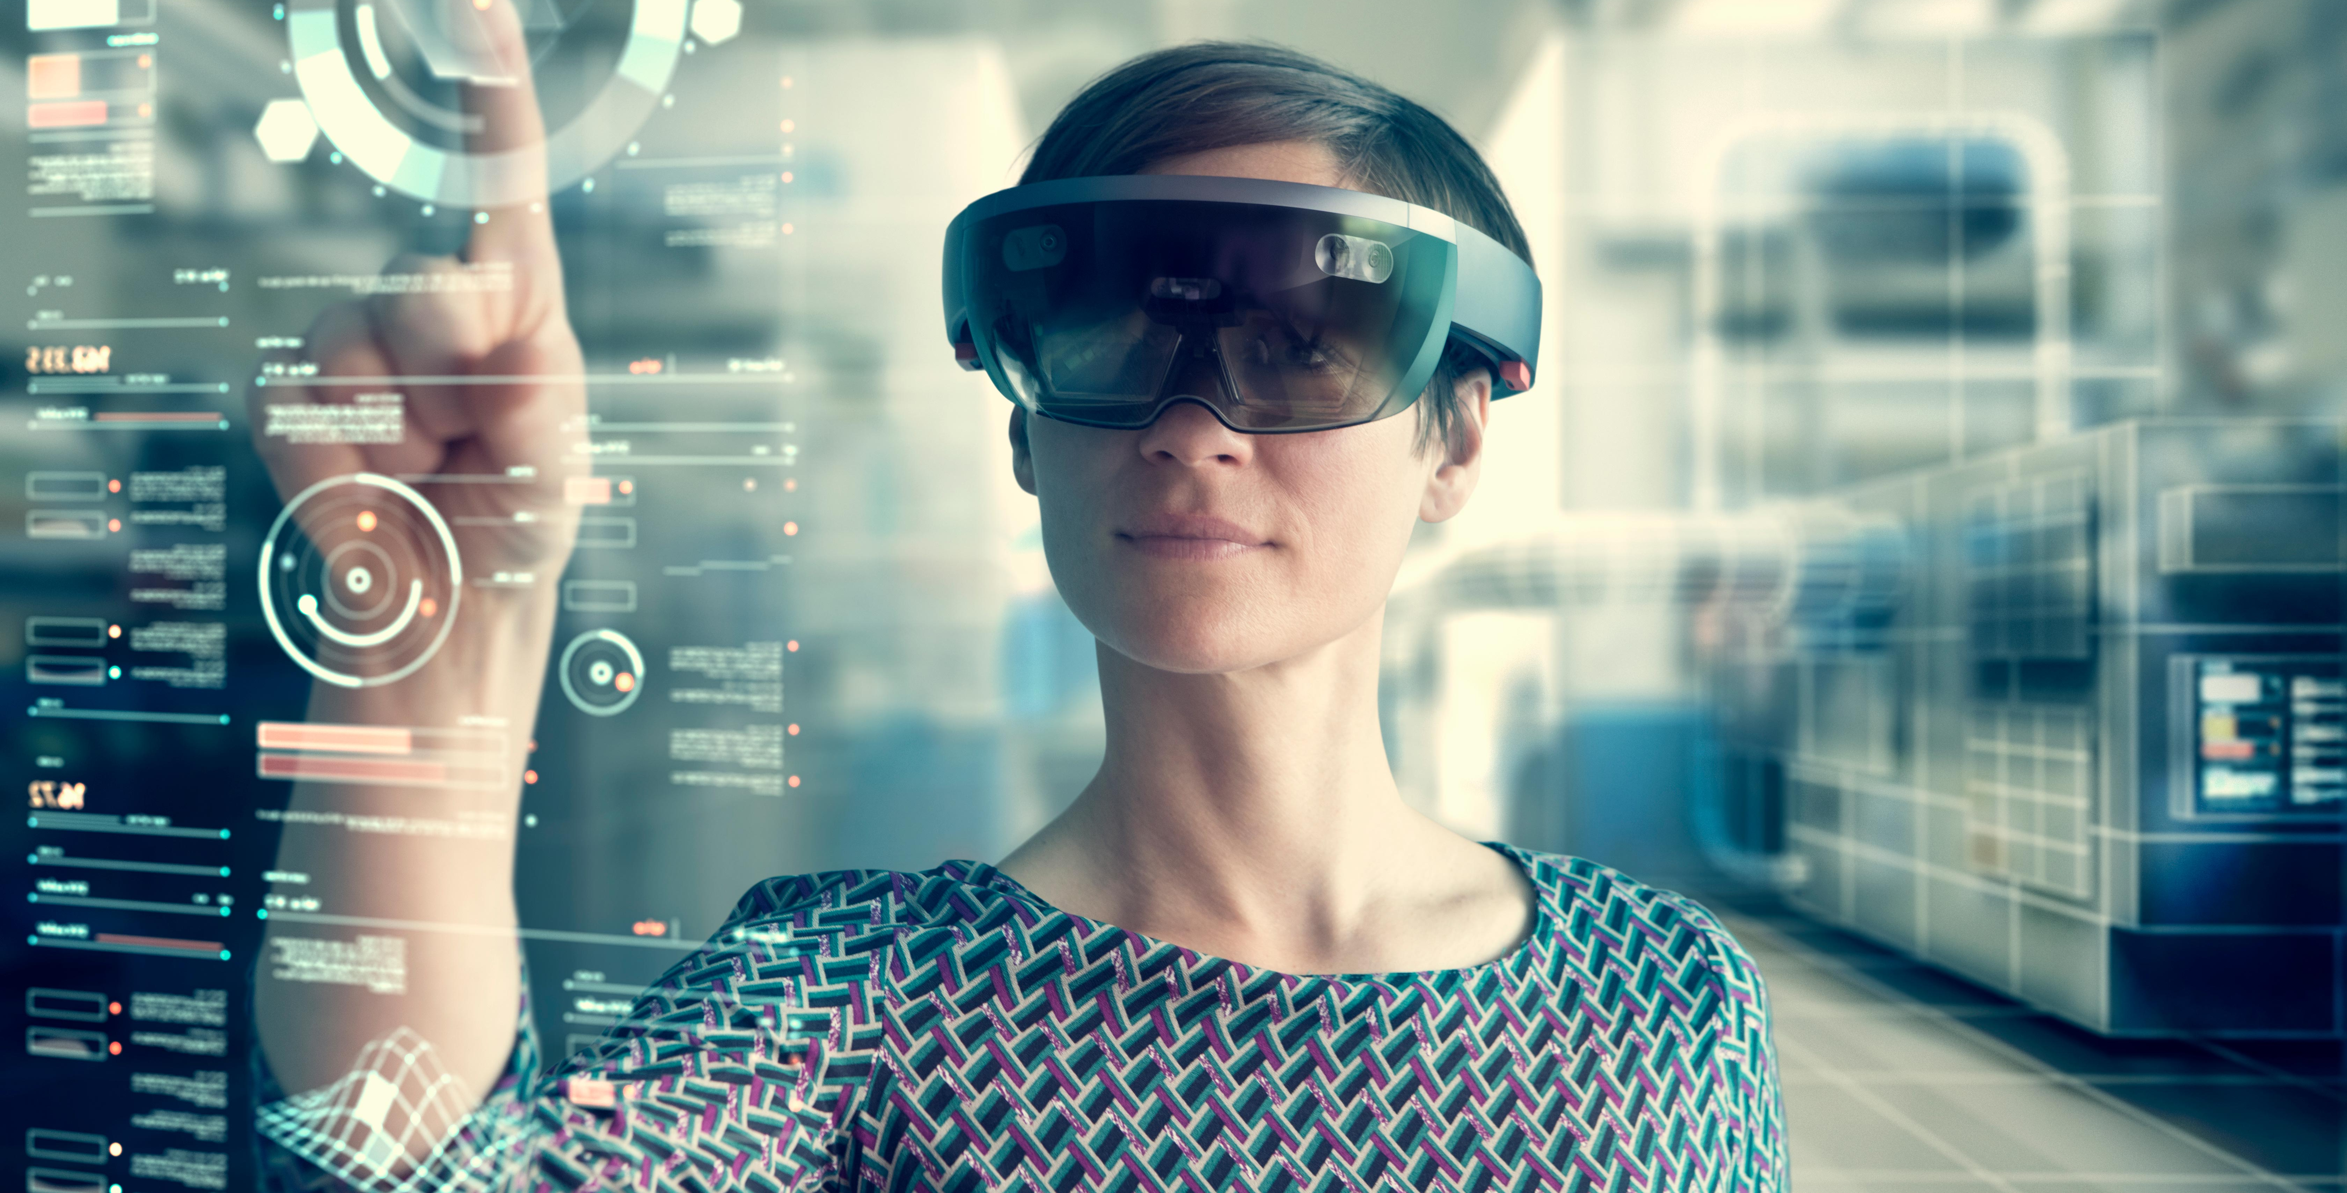
Development of an interaction concept for efficient multimedia annotations to 3D models in Augmented Reality
Master Thesis
Ruchir Naphade
Paderborn | 24.02.2021

Slide 2

Contents
Introduction
State of the art
Concept & Implementation
Evaluation
Summary & Future Work

Slide 3

Introduction
1

Slide 4




Design Review [Qua21]
Design
Build
Design Review Iteration Cycle
Aesthetics
Ergonomics
Usability
Functionality
Materials
Start
Define
Test
Output
Sign Off
Review, Change Plan / Sign off
Customers
Designers
Developers
Stakeholders

Slide 5






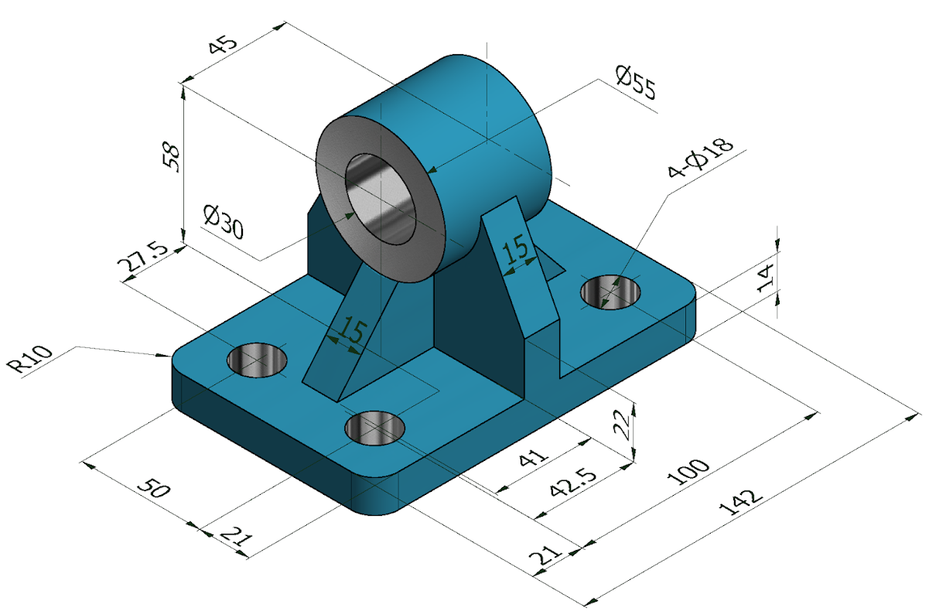
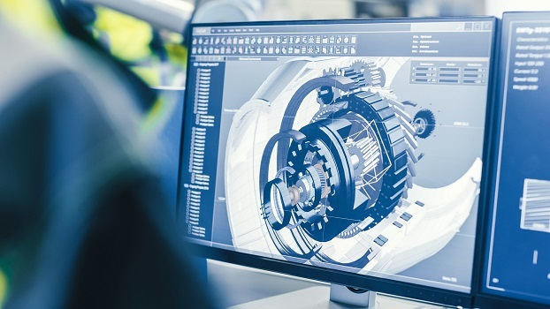
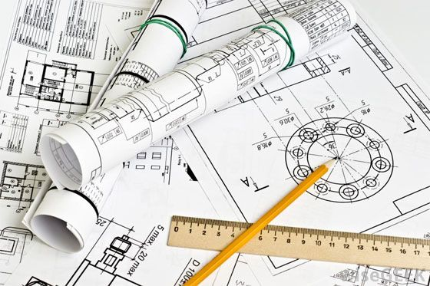
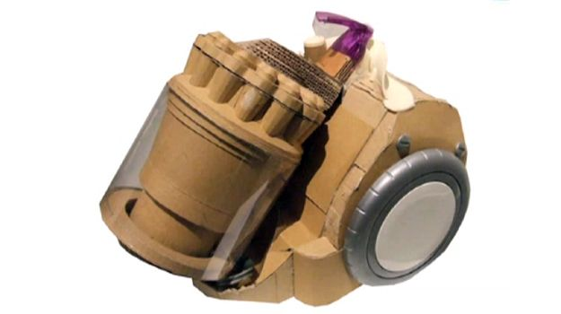
Traditional Design Review Approaches
2D Documents [ST07]
CAD Software [WZS+17]
Physical Prototype [CR10]
Virtual Prototype [Aro17]

Slide 6



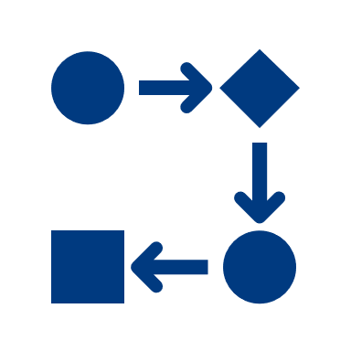






Traditional Design Review Approaches - Problems
2D Documents [ST07]
CAD Software [WZS+17]
Physical Prototype [CR10]
Virtual Prototype [Aro17]
Limited visualization
Unable to evaluate functionality
and ergonomics
Costly
Needs systematic
Process [Aro17]
Errors in documents
Needs knowledge of CAD
Time consuming
Unable to interact
Directly with
virtual models
[KHW+11]
Difficult to share
Unable to interact naturally

Slide 7
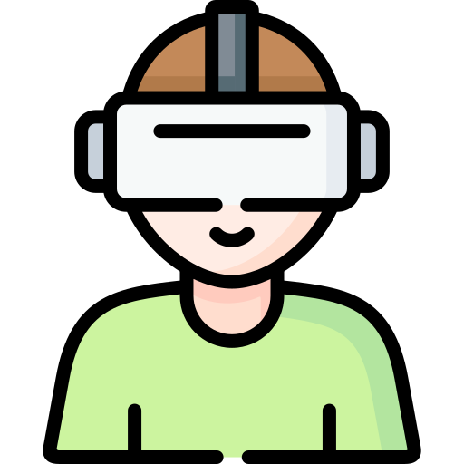
Immersive Technologies
2D Documents
Virtual Prototype
AR/VR
CAD Software
Physical Prototype

Slide 8




Potentials of Augmented Reality [GOG+18]
AR
Interactive visualization
Natural interaction
Enhanced visualization
Time/Cost efficient
Easy to share
Secure [McC21]

Slide 9




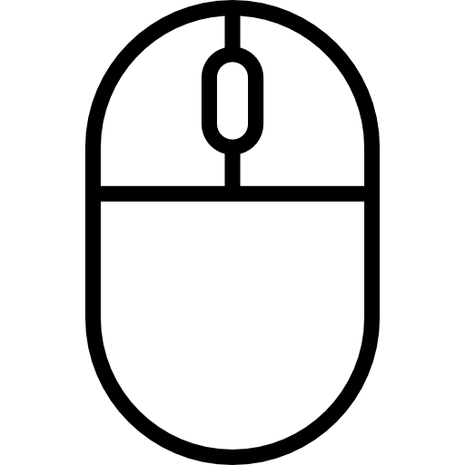
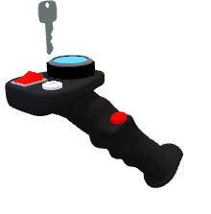

AR-based Design Review Approaches - Problems
AR
Absence of traditional input modalities
Absence of feedback provision mechanism [VVG+20]
Absence of feedback documentation mechanism

Slide 10





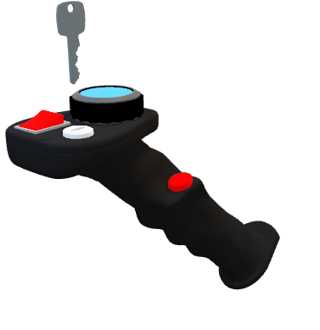
Goal
Interactive
Efficient
Feedback
Solution
Interaction
modalities
Intuitive
3D Model
Feedback

Slide 11

State of the art
2

Slide 12
Requirement Matrix
Evaluation scale |  | Requirements (R)
 |  | R1 | R2 | R3 | R4 | R5 | R6
AR | Comparison of CAD models on PC and HoloLens 2 [VVG+20]
 | AR-based real-time video annotation system [CK20]
 | AR tool to detect and annotate design variations [BBM+19]
 | AR to determine annotations in collocated learning [RHV+18]
 | Gesture based AR annotations [CNL+17]
 | Mobile AR for product evaluation [AO13]
VR | Usability study for building design review using VR [PI18]
 | Bi-directional interface between CAD and VR system [FSC18]
 | VR for interaction in automotive design review [CSD+17]
 | Low-cost VR tool to interact with 3D models [WZS+17]
 | Pre-meeting virtual environment for design intent and communication feedback [BHG17]
Not fulfilled
Partially fulfilled
Fully fulfilled
Requirements
R1
Interactive visualization
R2
Natural Interaction
R3
Feedback Provision
R4
Detailed Feedback
R5
Documentation of Feedback
R6
Cross platform

Slide 13
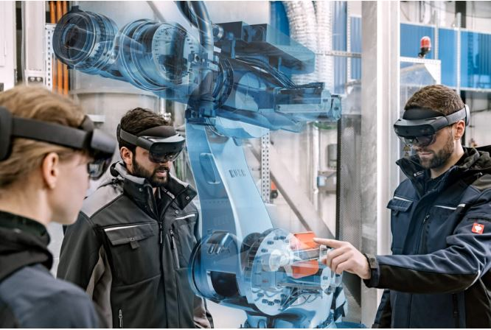


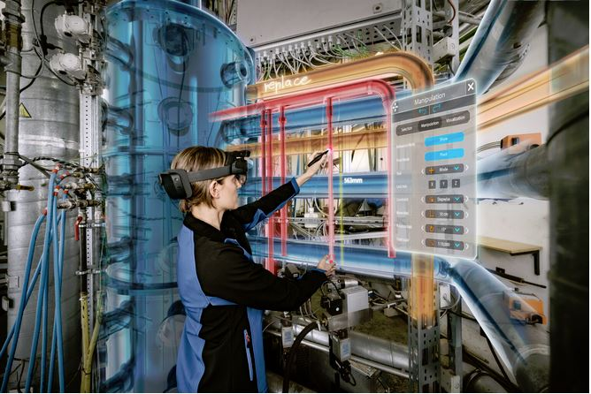

Holo-Light [Hol21]
ARES (Augmented Reality Engineering Space)
Microsoft HoloLens 2
Stylus XR
Stylus XR as AR/MR input device

Slide 14
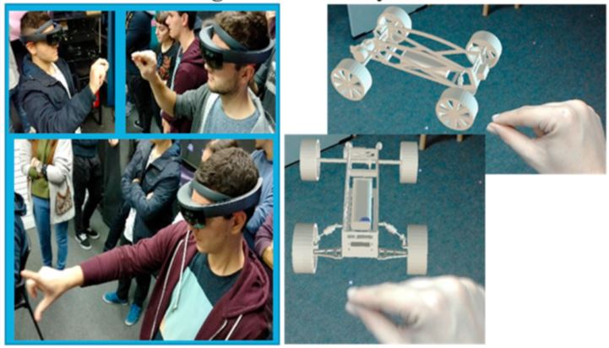




Design Evaluation using AR [MZV18]
CAD
Product requirements
Requirement evaluation and product design
Design Evaluation using AR

Slide 15

Concept & implementation
3

Slide 16



Feedback Solution
Natural
Interaction
Interactive visualization
Feedback
Provision
Feedback
Solution
Cross
Platform
Detailed
Feedback
Documentation
Of
Feedback

Slide 17




Feedback Solution
Platform independent
Platform dependent
Interaction
modalities
Visualization
functions
Feedback
Solution
HoloLens 2
Interaction
modalities
MRTK
Interaction
modalities
MRTK – Mixed Reality Toolkit [Mic21]

Slide 18
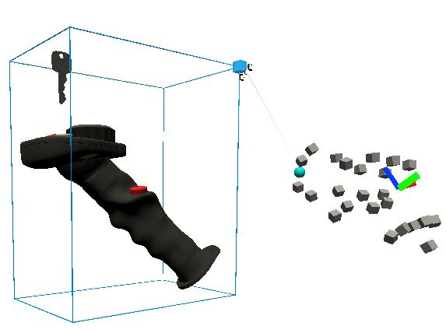
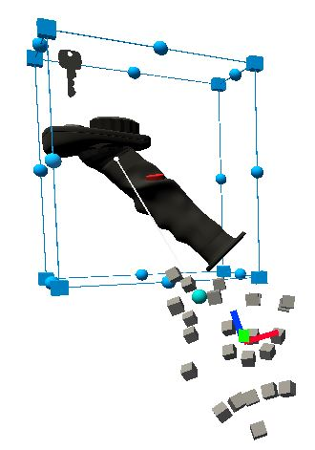
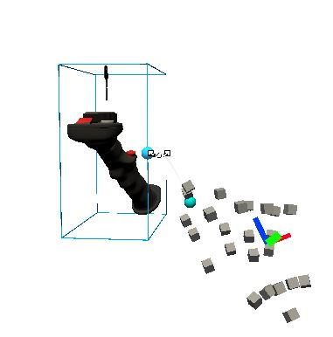
Visualization Functionalities
Transform
Scale
Feedback
Solution
Move
Rotate

Slide 19
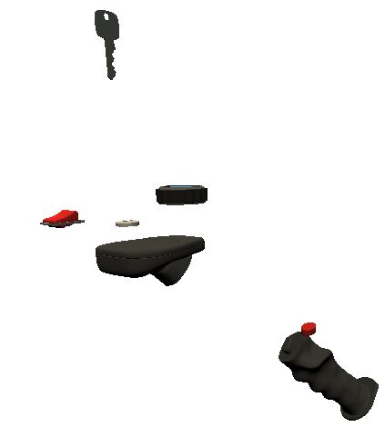
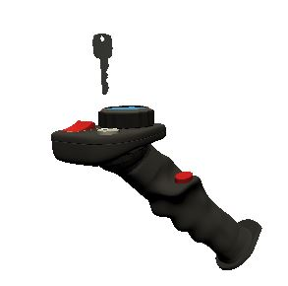
Visualization Functionalities
Transform
Exploded View
Feedback
Solution
Explode
Original View

Slide 20


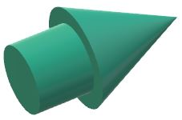

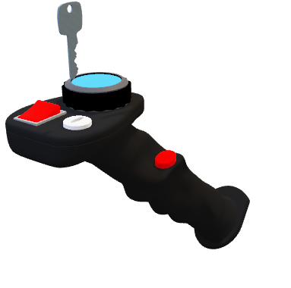
Feedback Functionalities
Simple Text
Change the color of the switch
Text annotation (SpeechToText)
Remove
Simple Text
Text annotation with icon (Ratings)
Feedback
Solution
4cm
3D Arrow
Freehand drawing
3D Model
Distance (cm)
Scale

Slide 21

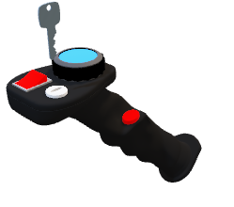
User Interface
Main Toolbar
Visualize
Feedback
Snapshot
Save
MRTK’s Interactable component attached to 3D model
at runtime
Transform
Explode
Reset
Ratings
Speech
Arrow
Draw
Measure
Visualize Toolbar
Feedback Toolbar

Slide 22


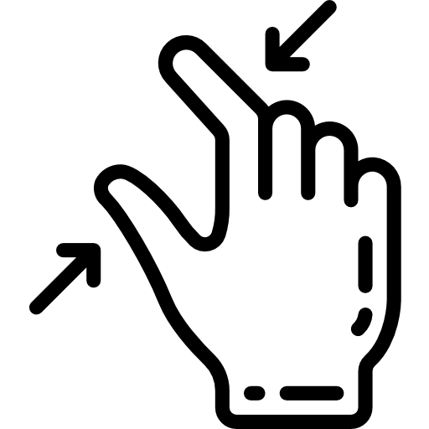



Interaction Modalities
Virtual touch
Air tap and hold
Feedback
Solution
Microsoft HoloLens 2
Speech Modality
Gesture Modality
Simple Text
Simple Text
10 cm

Slide 23



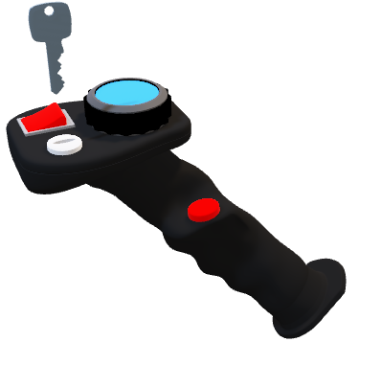
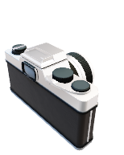
Feedback Documentation Functionalities
1. Snapshot
Snapshot
Save
Delete
Change the color of the switch
Change the color of the switch
Remove
CaptureSnapshot
Remove

Slide 24

Feedback Documentation Functionalities
<?xml version="1.0"?>
<ObjectDatabase>
<TooltipObject>
<toolTipType> Text with Icon </toolTipType>
<toolTipText> Rework </toolTipText>
<toolTipPosition> <x>0.13</x> <y>0.44</y> <z>0.96</z> </toolTipPosition>
<lineStartPosition> <x>0.13</x> <y>0.44</y> <z>0.96</z> </lineStartPosition>
<lineEndPosition> <x>0.13</x><y>0.44</y><z>0.96</z> </lineEndPosition>
<iconMaterial> ReworkRatingIcon (Instance) </iconMaterial>
</TooltipObject>
<ArrowObject>
<arrowPosition> <x>0.12</x> <y>-0.09</y> <z>0.60</z> </arrowPosition>
<arrowRotation> <x>54</x> <y>320</y> <z>1.16</z> </arrowRotation>
</ArrowObject>
<AirDrawObject>
<pointList>
<AirDrawPoint> <x>0.03</x> <y>0.12</y> <z>0.44</z> </AirDrawPoint>
<AirDrawPoint> <x>0.03</x> <y>0.12</y> <z>0.44</z> </AirDrawPoint>
….
</pointList>
</AirDrawObject>
<AirDrawObject>
<pointList>
….
….
</pointList>
</AirDrawObject>
</ObjectDatabase>
2. XML Serialization
Change the color of the switch
Remove
XMLDataExporter

Slide 25
Feedback Recreation Functionality
<?xml version="1.0"?>
<ObjectDatabase>
<TooltipObject>
<toolTipType> Text with Icon </toolTipType>
<toolTipText> Rework </toolTipText>
<toolTipPosition> <x>0.13</x> <y>0.44</y> <z>0.96</z> </toolTipPosition>
<lineStartPosition> <x>0.13</x> <y>0.44</y> <z>0.96</z> </lineStartPosition>
<lineEndPosition> <x>0.13</x><y>0.44</y><z>0.96</z> </lineEndPosition>
<iconMaterial>ReworkRatingIcon (Instance)</iconMaterial>
</TooltipObject>
<ArrowObject>
<arrowPosition> <x>0.12</x> <y>-0.09</y> <z>0.60</z> </arrowPosition>
<arrowRotation> <x>54</x> <y>320</y> <z>1.16</z> </arrowRotation>
</ArrowObject>
<AirDrawObject>
<pointList>
<AirDrawPoint <x>0.03</x> <y>0.12</y> <z>0.44</z> </AirDrawPoint>
<AirDrawPoint <x>0.03</x> <y>0.12</y> <z>0.44</z> </AirDrawPoint>
….
</pointList>
</AirDrawObject>
<AirDrawObject>
<pointList>
….
….
</pointList>
</AirDrawObject>
</ObjectDatabase>
Change the color of the switch
Remove
XMLDataImporter

Slide 26

Evaluation
4

Slide 27
Evaluation of Feedback Solution
Requirements
Design Aspects
Interactive visualization
Aesthetics
Natural Interaction
Ergonomics
Feedback Provision
Usability
Detailed Feedback
Feedback
Solution
Functionality
Documentation of Feedback
Materials
Cross platform

Slide 28

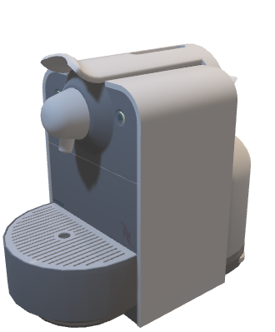
Evaluation of Feedback Solution
Visualization functionalities
Feedback functionalities
Feedback
Solution
Documentation functionalities
3D (FBX) Model of
a coffee machine [Eds21]

Slide 29
Evaluation of Visualization Functionalities
Kindly check visualization video in Presentation video folder

Slide 30
Evaluation of Feedback Functionalities
Kindly check feedack video in Presentation video folder

Slide 31
Evaluation of Feedback Documentation Functionalities
Kindly check feedback documentation video in Presentation video folder

Slide 32
Evaluation of Feedback Recreation Functionality
Kindly check feedback recreation video in Presentation video folder

Slide 33

Summary & Future work

Slide 34

Summary
Requirements
Aesthetics
Ergonomics
Usability
Functionality
Materials
Interactive visualization
Natural Interaction
Feedback Provision
Feedback
Solution
Detailed Feedback
Documentation of Feedback
Cross platform

Slide 35

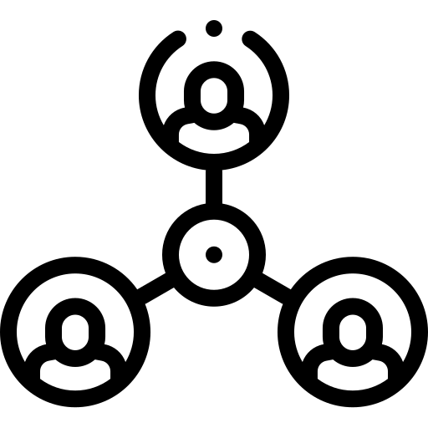
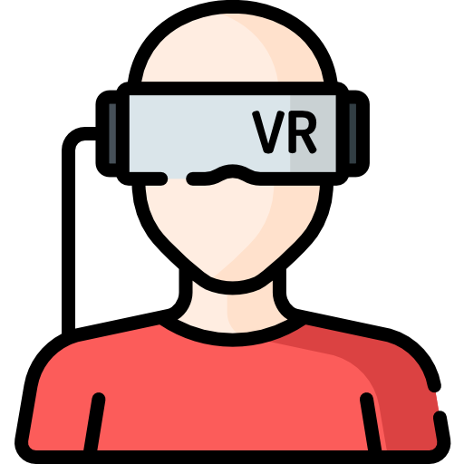
Future Work
Unity UI components can be used to make the solution more platform-independent
Manipulation of freehand drawings
Multi-user functionality
Solution can be extended to VR-based design review processes

Slide 36
References
[Qua21] QUALITYINSPECTION: Design Review Iterations (New Product Development) - https://qualityinspection.org/design-review-iterations-china
[ST07] SHIRATUDDIN, M. F.; THABET, W.: Information rich Virtual Environment (VE) for design review. (2007)
[WZS+17] WOLFARTSBERGER, J.; ZENISEK, J.; SIEVI, C. ; SILMBROTH, M.: A virtual reality supported 3D environment for engineering design review. In: 2017 23rd International Conference on Virtual System & Multimedia (VSMM) IEEE, 2017, P. 1–8
[CR10] CARUSO, G.; RE, G. M.: Interactive augmented reality system for product design review. In: The Engineering Reality of Virtual Reality 2010 Bd. 7525 International Society for Optics and Photonics, 2010, P. 75250H
[Aro17] AROMAA, S.: Virtual prototyping in design reviews of industrial systems. In: Proceedings of the 21st International Academic Mindtrek Conference, 2017, P. 110–119
[GOG+18] GIUNTA, L.; O’HARE, J.; GOPSILL, J.; DEKONINCK, E. u. a.: A Review of Augmented Reality Research for Design Practice: Looking to the Future. In: DS 91: Proceedings of NordDesign 2018, Linkoping, Sweden, 14th-17th August 2018 (2018)
[McC21] MCCLINTOK, C.: Why You Should Invite Augmented Reality to Your Next Design Review — PTC. https://www:ptc:com/en/cad-software-blog/why-invite-ar-to-next-design-review. Last accessed: 02/01/2021

Slide 37
References
[BHG17] BERG, M. van d.; HARTMANN, T. ; GRAAF, R. de: Supporting design reviews with pre-meeting virtual reality environments. In: Journal of Information Technology in Construction (ITcon) 22 (2017), Nr. 16, P. 305–321
[KHW+11] KUMAR, S.; HEDRICK, M.; WIACEK, C. ; MESSNER, J. I.: Developing an experienced- based design review application for healthcare facilities using a 3D game engine. In: Journal of Information Technology in Construction (ITcon) 16 (2011), Nr. 6, P. 85–104
[VVG+20] VAN GOETHEM, S.; VERLINDEN, J.; GARCIA, I.; DEGRYSE, R.; PERDIEUS, S.; WATTS, R. ; VERWULGEN, S.: The Use of Immersive Technologies for Design Reviews. In: International Conference on Applied Human Factors and Ergonomics Springer, 2020, P. 656–662
[CK20] CAO, D.; KIM, S.: Augmented Reality Annotation for Real-Time Collaboration System. In: Journal of Korea Multimedia Society 23 (2020), Nr. 3, P. 483–489
[BBM+19] BRUNO, F.; BARBIERI, L.; MARINO, E.; MUZZUPAPPA, M.; D’ORIANO, L. ; COLACINO, B.: An augmented reality tool to detect and annotate design variations in an Industry 4.0 approach. In: The International Journal of Advanced Manufacturing Technology 105 (2019), Nr. 1-4, P. 875–887
[RHV+18] REINOSO, M.; HOANG, T. N.; VETERE, F. ; TANIN, E.: Annotating Animated AR Objects for Co-located Learning. In: 2018 IEEE International Conference on Teaching, Assessment, and Learning for Engineering (TALE) IEEE, 2018, P. 470–477

Slide 38
References
[CNL+17] CHANG, Y. S.; NUERNBERGER, B.; LUAN, B.; H¨O LLERER, T. ; O’DONOVAN, J.: Gesture-based augmented reality annotation. In: 2017 IEEE Virtual Reality (VR) IEEE, 2017, P. 469–470
[AO13] ARBEL´A EZ-ESTRADA, J. C.; OSORIO-G´O MEZ, G.: Augmented Reality Application for Product Concepts Evaluation. In: Procedia Computer Science 25 (2013), P. 389–398
PI[18] PAES, D.; IRIZARRY, J.: A usability study of an immersive virtual reality platform for building design review: Considerations on human factors and user interface. In: Construction Research Congress Bd. 2018, 2018
[FSC18] FREEMAN, I.; SALMON, J. ; COBURN, J.: A bi-directional interface for improved interaction with engineering models in virtual reality design reviews. In: International Journal on Interactive Design and Manufacturing (IJIDeM) 12 (2018), Nr. 2, P. 549–560
[CSD+17] CLERK, M. de; SCHMIERER, G.; DANGELMAIER, M. ; SPATH, D.: Interaction techniques for virtual reality based automotive design reviews. In: International Conference on Virtual Reality and Augmented Reality Springer, 2017, P. 39–48
[Hol21] HOLO-LIGHT GMBH: ARES - AR Software for Engineers & Industrial Designers. https://holo-light:com/products/ares/. Last accessed: 02/01/2021
[MZV18] MOURTZIS, D.; ZOGOPOULOS, V. ; VLACHOU, E.: Augmented reality supported product design towards industry 4.0: A teaching factory paradigm. In: Procedia manufacturing 23 (2018), P. 207–212

Slide 39
References
[Mic21] MICROSOFT CORPORATION: Welcome to MRTK – Mixed Reality Toolkit Documentation. https://microsoft.github.io/MixedRealityToolkit-Unity/Documentation/WelcomeToMRTK.html
[Eds21] EDSON,L.: Coffee reissued 3D — CGTrader. https://www.cgtrader.com/free-3d-models/household/kitchenware/coffee-reissued.Last accessed: 02/01/2021

Slide 40
Thank You!
!
Hintergrundbild-Platzhalter ist deaktiviert
→ über Menü „Start“ → Reiter „Bearbeiten“ → „Markieren“ → „Auswahlbereich“ → Ebene „Bild“ Symbol „Auge“ aktivieren → Bild in Platzhalter einfügen

